Slide 1
William Stallings Computer Organization and Architecture
Chapter 7
Operating System
Support
‹#›

Slide 2
Fungsi Sistem Operasi
Sistem operasi merupakan program yang mengontrol eksekusi program aplikasi dan bertindak sebagai antarmuka antara pengguna komputer dengan hardware
‹#›

Slide 3
Tujuan Sistem Operasi
Sistem Operasi Mempunyai 2 Tujuan :
Kenyamanan : Suatu sistem operasi membuat komputer lebih mudah digunakan
Efisiensi : Suatu sistem operasi memungkinkan sumber daya sistem komputer dapat digunakan dengan cara yang efisien
‹#›

Slide 4
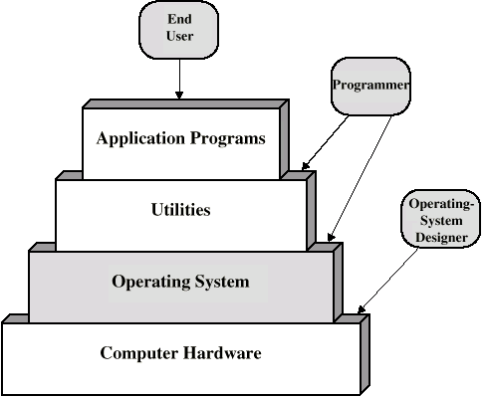
Layers and Views of a Computer System
‹#›

Slide 5
Layanan Sistem Operasi
Pembuatan Program
Eksekusi Program
Access to I/O devices
Akses Terkontrol ke file
Akses Sistem
Pendeteksi Kesalahan
Akuntansi
www.agungyuliantonugroho.com
‹#›

Slide 6
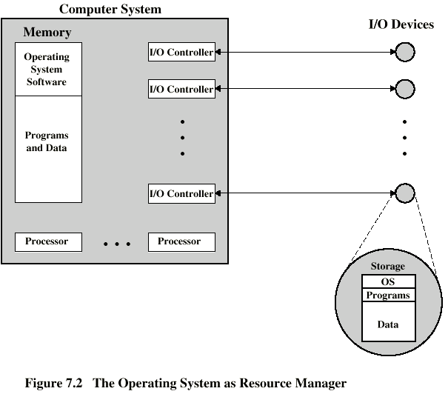
O/S as a Resource Manager
www.agungyuliantonugroho.com
‹#›

Slide 7
Jenis Sistem Operasi
Interactive
Batch
Single program (Uni-programming)
Multi-programming (Multi-tasking)
www.agungyuliantonugroho.com
‹#›

Slide 8
Early Systems
Late 1940s to mid 1950s
No Operating System
Programs interact directly with hardware
Two main problems:
Scheduling
Setup time
‹#›

Slide 9
Simple Batch Systems
Prosesor masa awal sangat mahal, dan oleh karena itu sangat penting untuk memaksimalkan pemanfaatan prosesor. Waktu yang disia-siakan dalam kaitan dengan waktu penjadwalan dan waktu setup sangat sulit untuk diterima.
Untuk meningkatkan pemanfaatan dikembangkan sistem operasi bacth sederhana.
‹#›

Slide 10
Fitur-fitur perangkat keras
Perlindungan Memori Pada saat program pengguna dieksekusi, maka program itu tidak harus mengubah area memory yg berisi monitor. Jika terjaadi perubahan area memori maka prosesor akan mendeteksi kesalahan dan kontrol transfer ke monitor
Pengatur waktu Pengatur waktu digunakan untuk mencegah sebuah tugas memonopoli sistem
Instruksi-instruksi istimewa Instruksi yang diistimewakan adalah instruksi I/O
Interupsi Fitur yang memberikan SO lebih flexibel dalam melepaskan kontrol ke program pengguna dan mendapatkan kembali kontrol tersebut
www.agungyuliantonugroho.com
‹#›

Slide 11
Multi-programmed Batch Systems
I/O devices very slow
When one program is waiting for I/O, another can use the CPU
‹#›

Slide 12
Single Program
‹#›

Slide 13
Multi-Programming with Two Programs
‹#›

Slide 14
Multi-Programming with Three Programs
‹#›

Slide 15
Time Sharing Systems
Allow users to interact directly with the computer
i.e. Interactive
Multi-programming allows a number of users to interact with the computer
www.agungyuliantonugroho.com
‹#›

Slide 16
Scheduling
Key to multi-programming
Long term
Medium term
Short term
I/O
‹#›

Slide 17
Long Term Scheduling
Determines which programs are submitted for processing
i.e. controls the degree of multi-programming
Once submitted, a job becomes a process for the short term scheduler
(or it becomes a swapped out job for the medium term scheduler)
‹#›

Slide 18
Medium Term Scheduling
Part of the swapping function (later…)
Usually based on the need to manage multi-programming
If no virtual memory, memory management is also an issue
www.agungyuliantonugroho.com
‹#›

Slide 19
Short Term Scheduler
Dispatcher
Fine grained decisions of which job to execute next
i.e. which job actually gets to use the processor in the next time slot
www.agungyuliantonugroho.com
‹#›

Slide 20
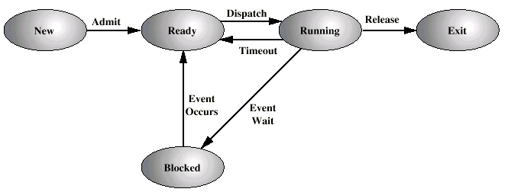
Process States
www.agungyuliantonugroho.com
‹#›

Slide 21
Process Control Block
Identifier
State
Priority
Program counter
Memory pointers
Context data
I/O status
Accounting information
‹#›

Slide 22
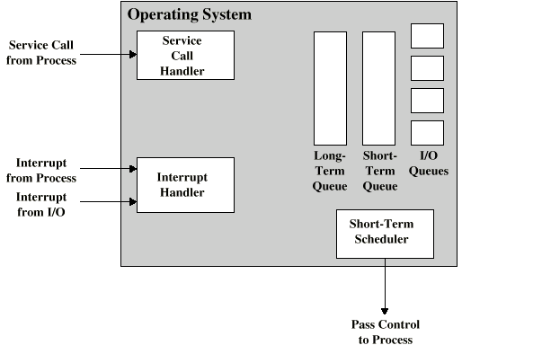
Key Elements of O/S
www.agungyuliantonugroho.com
‹#›

Slide 23
Process Scheduling
Process
Request
Long-Term
Queue
Short-Term
Queue
End
CPU
I/O
I/O Queue
I/O
I/O Queue
I/O
I/O Queue
‹#›

Slide 24
Memory Management
Uni-program
Memory split into two
One for Operating System (monitor)
One for currently executing program
Multi-program
“User” part is sub-divided and shared among active processes
www.agungyuliantonugroho.com
‹#›

Slide 25
Swapping
Problem: I/O is so slow compared with CPU that even in multi-programming system, CPU can be idle most of the time
Solutions:
Increase main memory
Expensive
Leads to larger programs
Swapping
www.agungyuliantonugroho.com
‹#›

Slide 26
What is Swapping?
Long term queue of processes stored on disk
Processes “swapped” in as space becomes available
As a process completes it is moved out of main memory
If none of the processes in memory are ready (i.e. all I/O blocked)
Swap out a blocked process to intermediate queue
Swap in a ready process or a new process
But swapping is an I/O process...
www.agungyuliantonugroho.com
‹#›

Slide 27
Partitioning
Splitting memory into sections to allocate to processes (including Operating System)
Fixed-sized partitions
May not be equal size
Process is fitted into smallest hole that will take it (best fit)
Some wasted memory
Leads to variable sized partitions
‹#›

Slide 28
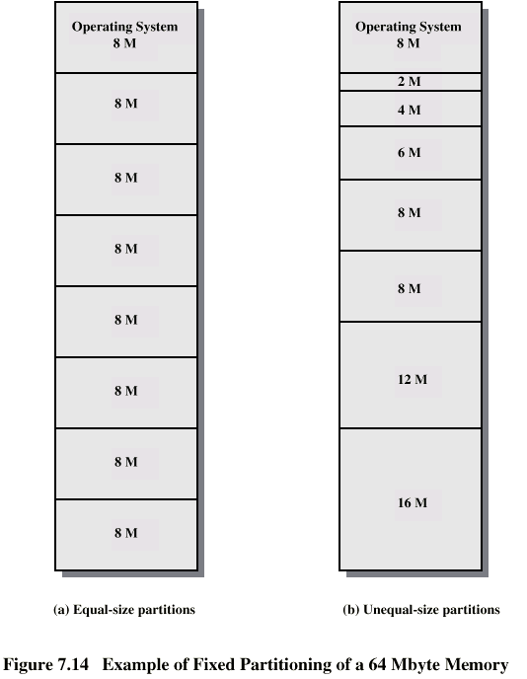
Fixed Partitioning
www.agungyuliantonugroho.com
‹#›

Slide 29
Variable Sized Partitions (1)
Allocate exactly the required memory to a process
This leads to a hole at the end of memory, too small to use
Only one small hole - less waste
When all processes are blocked, swap out a process and bring in another
New process may be smaller than swapped out process
Another hole
‹#›

Slide 30
Variable Sized Partitions (2)
Eventually have lots of holes (fragmentation)
Solutions:
Coalesce - Join adjacent holes into one large hole
Compaction - From time to time go through memory and move all hole into one free block (c.f. disk de-fragmentation)
www.agungyuliantonugroho.com
‹#›

Slide 31
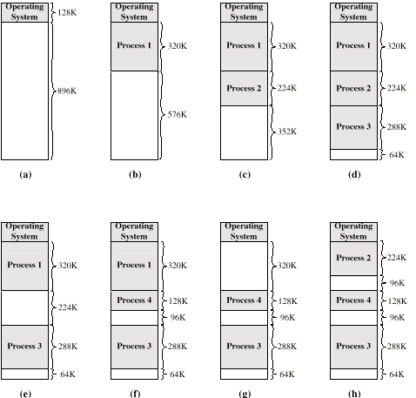
Effect of Dynamic Partitioning
www.agungyuliantonugroho.com
‹#›

Slide 32
Relocation
No guarantee that process will load into the same place in memory
Instructions contain addresses
Locations of data
Addresses for instructions (branching)
Logical address - relative to beginning of program
Physical address - actual location in memory (this time)
Automatic conversion using base address
‹#›

Slide 33
Paging
Split memory into equal sized, small chunks -page frames
Split programs (processes) into equal sized small chunks - pages
Allocate the required number page frames to a process
Operating System maintains list of free frames
A process does not require contiguous page frames
Use page table to keep track
‹#›

Slide 34
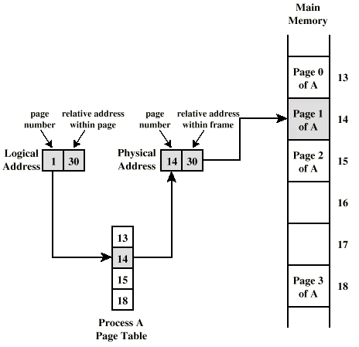
Logical and Physical Addresses - Paging
www.agungyuliantonugroho.com
‹#›

Slide 35
Virtual Memory
Demand paging
Do not require all pages of a process in memory
Bring in pages as required
Page fault
Required page is not in memory
Operating System must swap in required page
May need to swap out a page to make space
Select page to throw out based on recent history
‹#›

Slide 36
Thrashing
Too many processes in too little memory
Operating System spends all its time swapping
Little or no real work is done
Disk light is on all the time
Solutions
Good page replacement algorithms
Reduce number of processes running
Fit more memory
‹#›

Slide 37
Bonus
We do not need all of a process in memory for it to run
We can swap in pages as required
So - we can now run processes that are bigger than total memory available!
Main memory is called real memory
User/programmer sees much bigger memory - virtual memory
www.agungyuliantonugroho.com
‹#›

Slide 38
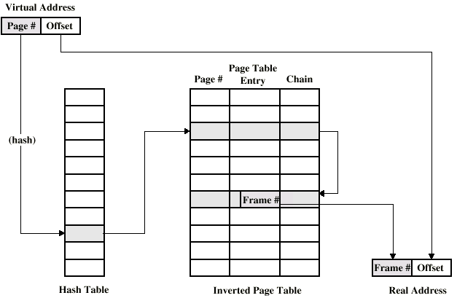
Page Table Structure
‹#›

Slide 39
Segmentation
Paging is not (usually) visible to the programmer
Segmentation is visible to the programmer
Usually different segments allocated to program and data
May be a number of program and data segments
‹#›

Slide 40
Advantages of Segmentation
Simplifies handling of growing data structures
Allows programs to be altered and recompiled independently, without re-linking and re-loading
Lends itself to sharing among processes
Lends itself to protection
Some systems combine segmentation with paging
‹#›

Slide 41
Required Reading
Stallings chapter 7
Stallings, W. Operating Systems, Internals and Design Principles, Prentice Hall 1998
Loads of Web sites on Operating Systems
‹#›

